Slide 1


Artful Accessibility -
Individuals with Mobility Disabilities in Art Exhibition
Final Project Phase A-61998
24-2-D-6
Marysoul Karawany
Mustafa Shama
Supervisor:
Dr. Julia Sheidin

Slide 2

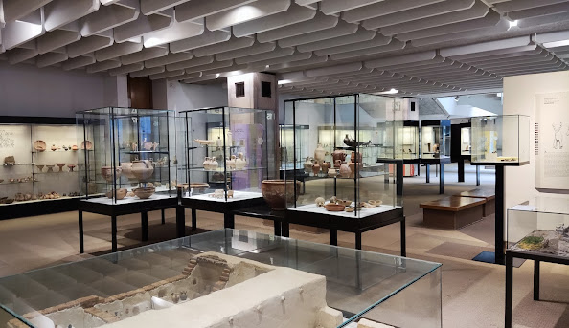

Introduction
The Hecht Museum, founded in 1984, located at the University of Haifa, offers a rich collection of archaeological artifacts and art.

Slide 3
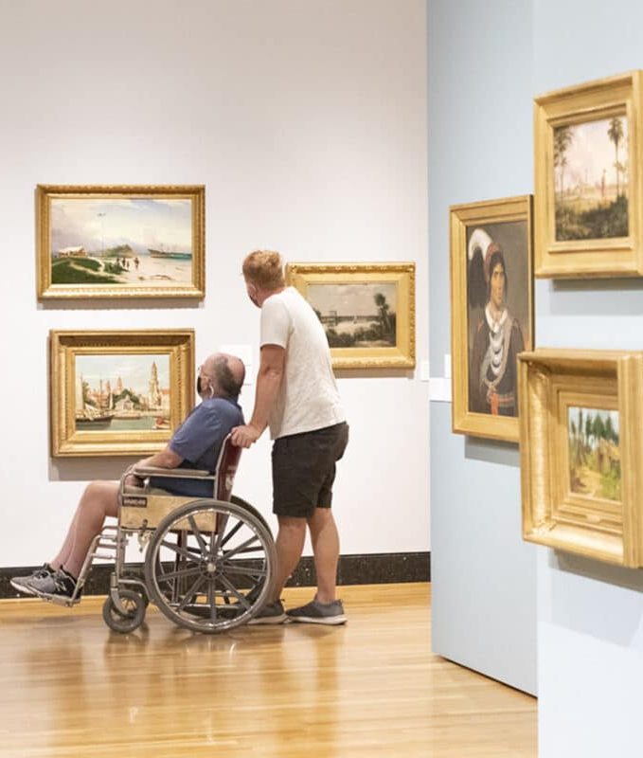
Background Research
Museums offer accommodations for various needs, but gaps remain.
Focuses on improving accessibility for visitors with mobility limitations.

Slide 4

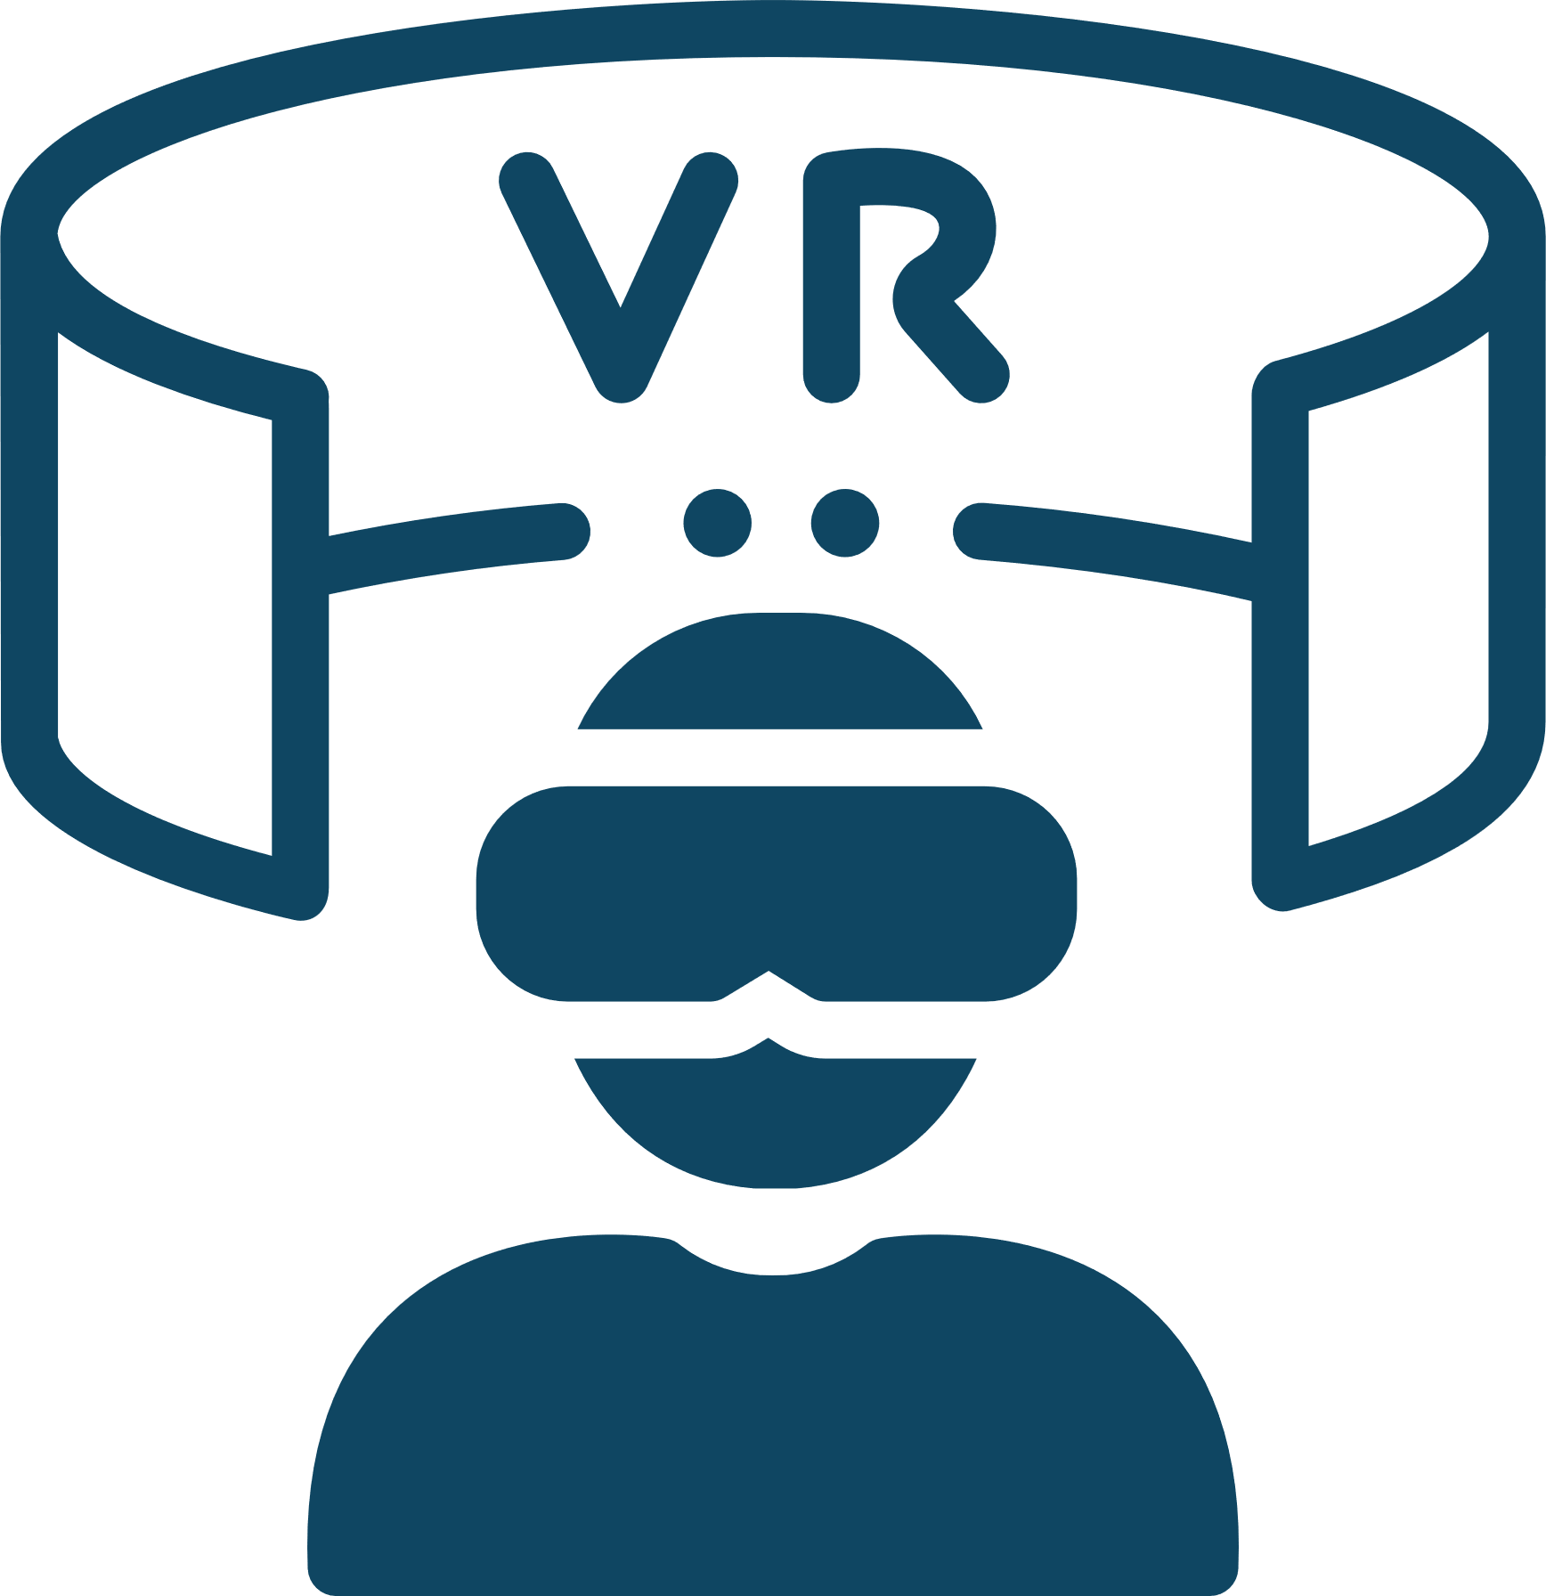

Existing Solutions for Mobility Impairments in Museums
Virtual Tours:
Remote exploration of museum spaces.
Augmented Reality (AR) & Virtual Reality (VR):
Immersive, interactive digital experiences.
Adjustable Seating:
Adjust seating height for comfortable viewing.

Slide 5

The Problem
Limited visibility of artwork due to fixed display heights, restricting accessibility for visitors of mobility.
The Solution
Involves an automated height-adjustment system that detects visitor height and adjusts artwork displays for optimal viewing, ensuring accessibility for all, including those with mobility disabilities.

Slide 6
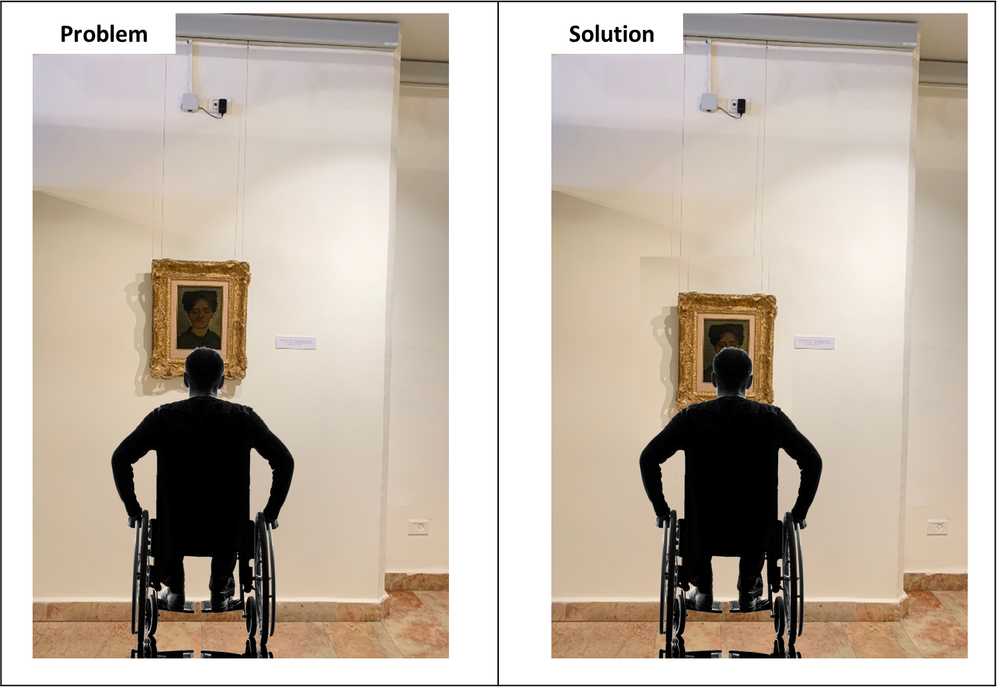

Slide 7

Project Goal
Our goal is to enhance accessibility for all visitors by implementing an automated system that adjusts artwork heights based on visitor needs.

Slide 8
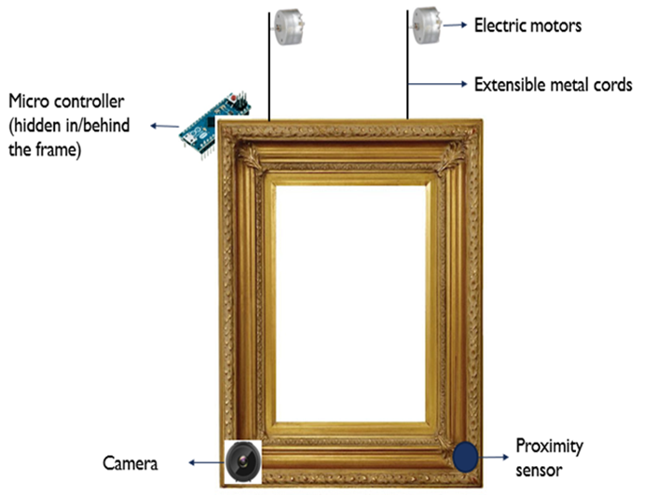
The proposed system
Notes:
\

Slide 9
Main Functional Requirements
1- Visitor Detection :
The system detects visitors, including wheelchair’s users, with computer vision Machine Learning and sensors.
2. Artwork height Adjustment:
The system adjusts artwork height with motorized controls and returns to the original position after the visitor leaves.
3. System Communication and Calibration:
The system should ensure reliable Wi-Fi communication between accurate calibration for real-time height adjustments and ML detection via Wi-Fi.

Slide 10
Main Non-Functional Requirements
1. System Performance and Reliability:
Ensure minimal failures, real-time responsiveness, and energy efficiency.
2. Usability and Durability:
Ensure precise detection and height adjustment with durable, high-quality components resistant to environmental factors.

Slide 11
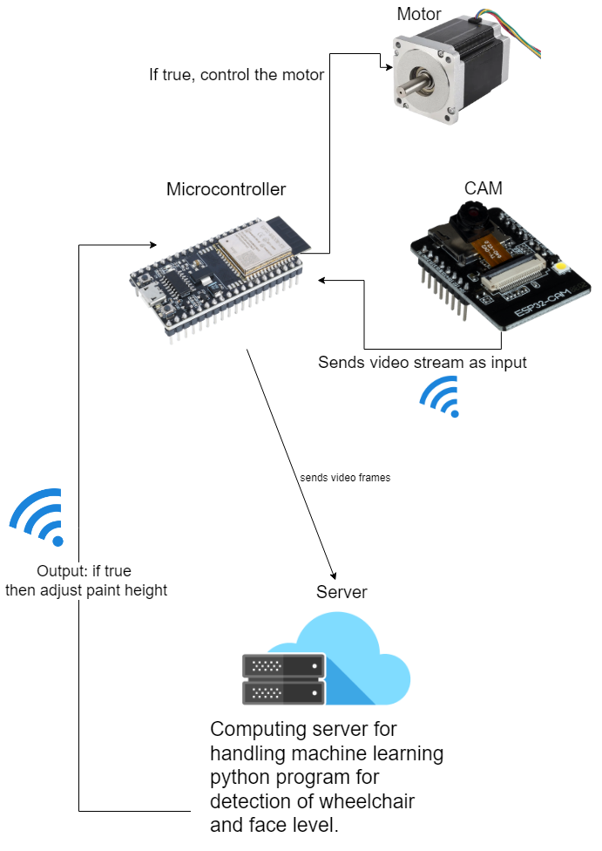
System
Architecture

Slide 12
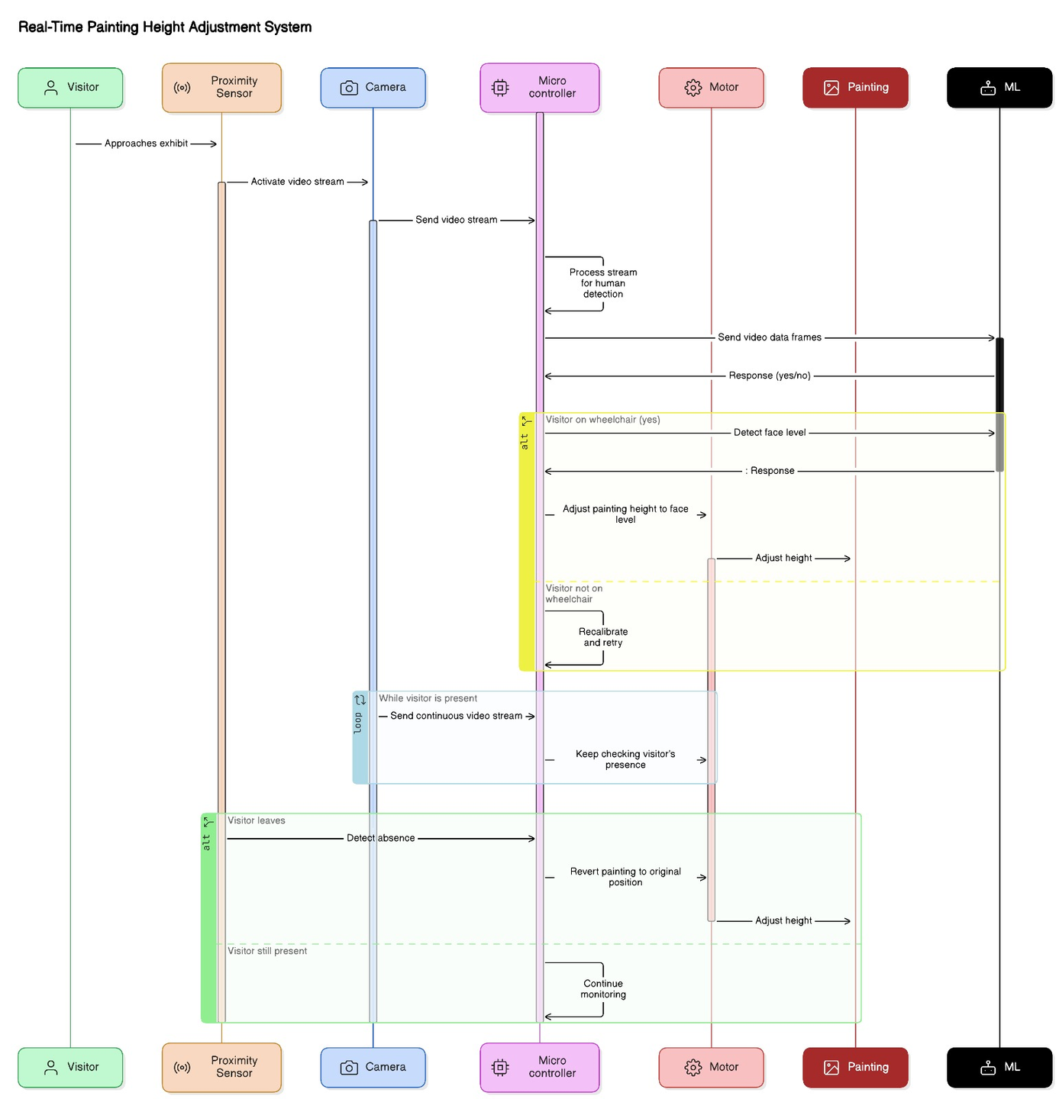
Sequence
Diagram

Slide 13
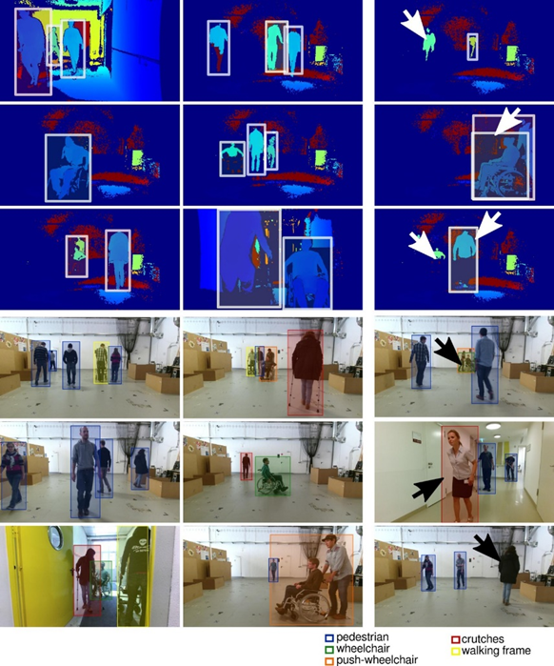
YOLO Algorithm for
object detection
Fast: Detects objects in real time.
Single-step Prediction: Predicts both object locations and classes in one evaluation.
Multi-object Detection: Identifies multiple objects simultaneously.
Lightweight: Efficient enough to integrate easily with control systems for dynamic adjustments.

Slide 14



Verification Plan
Pilot Test: Single artwork deployment to identify issues.
Response Time: Assess the speed of height adjustments.
Detection Accuracy: Evaluate face and wheelchair recognition.

Slide 15
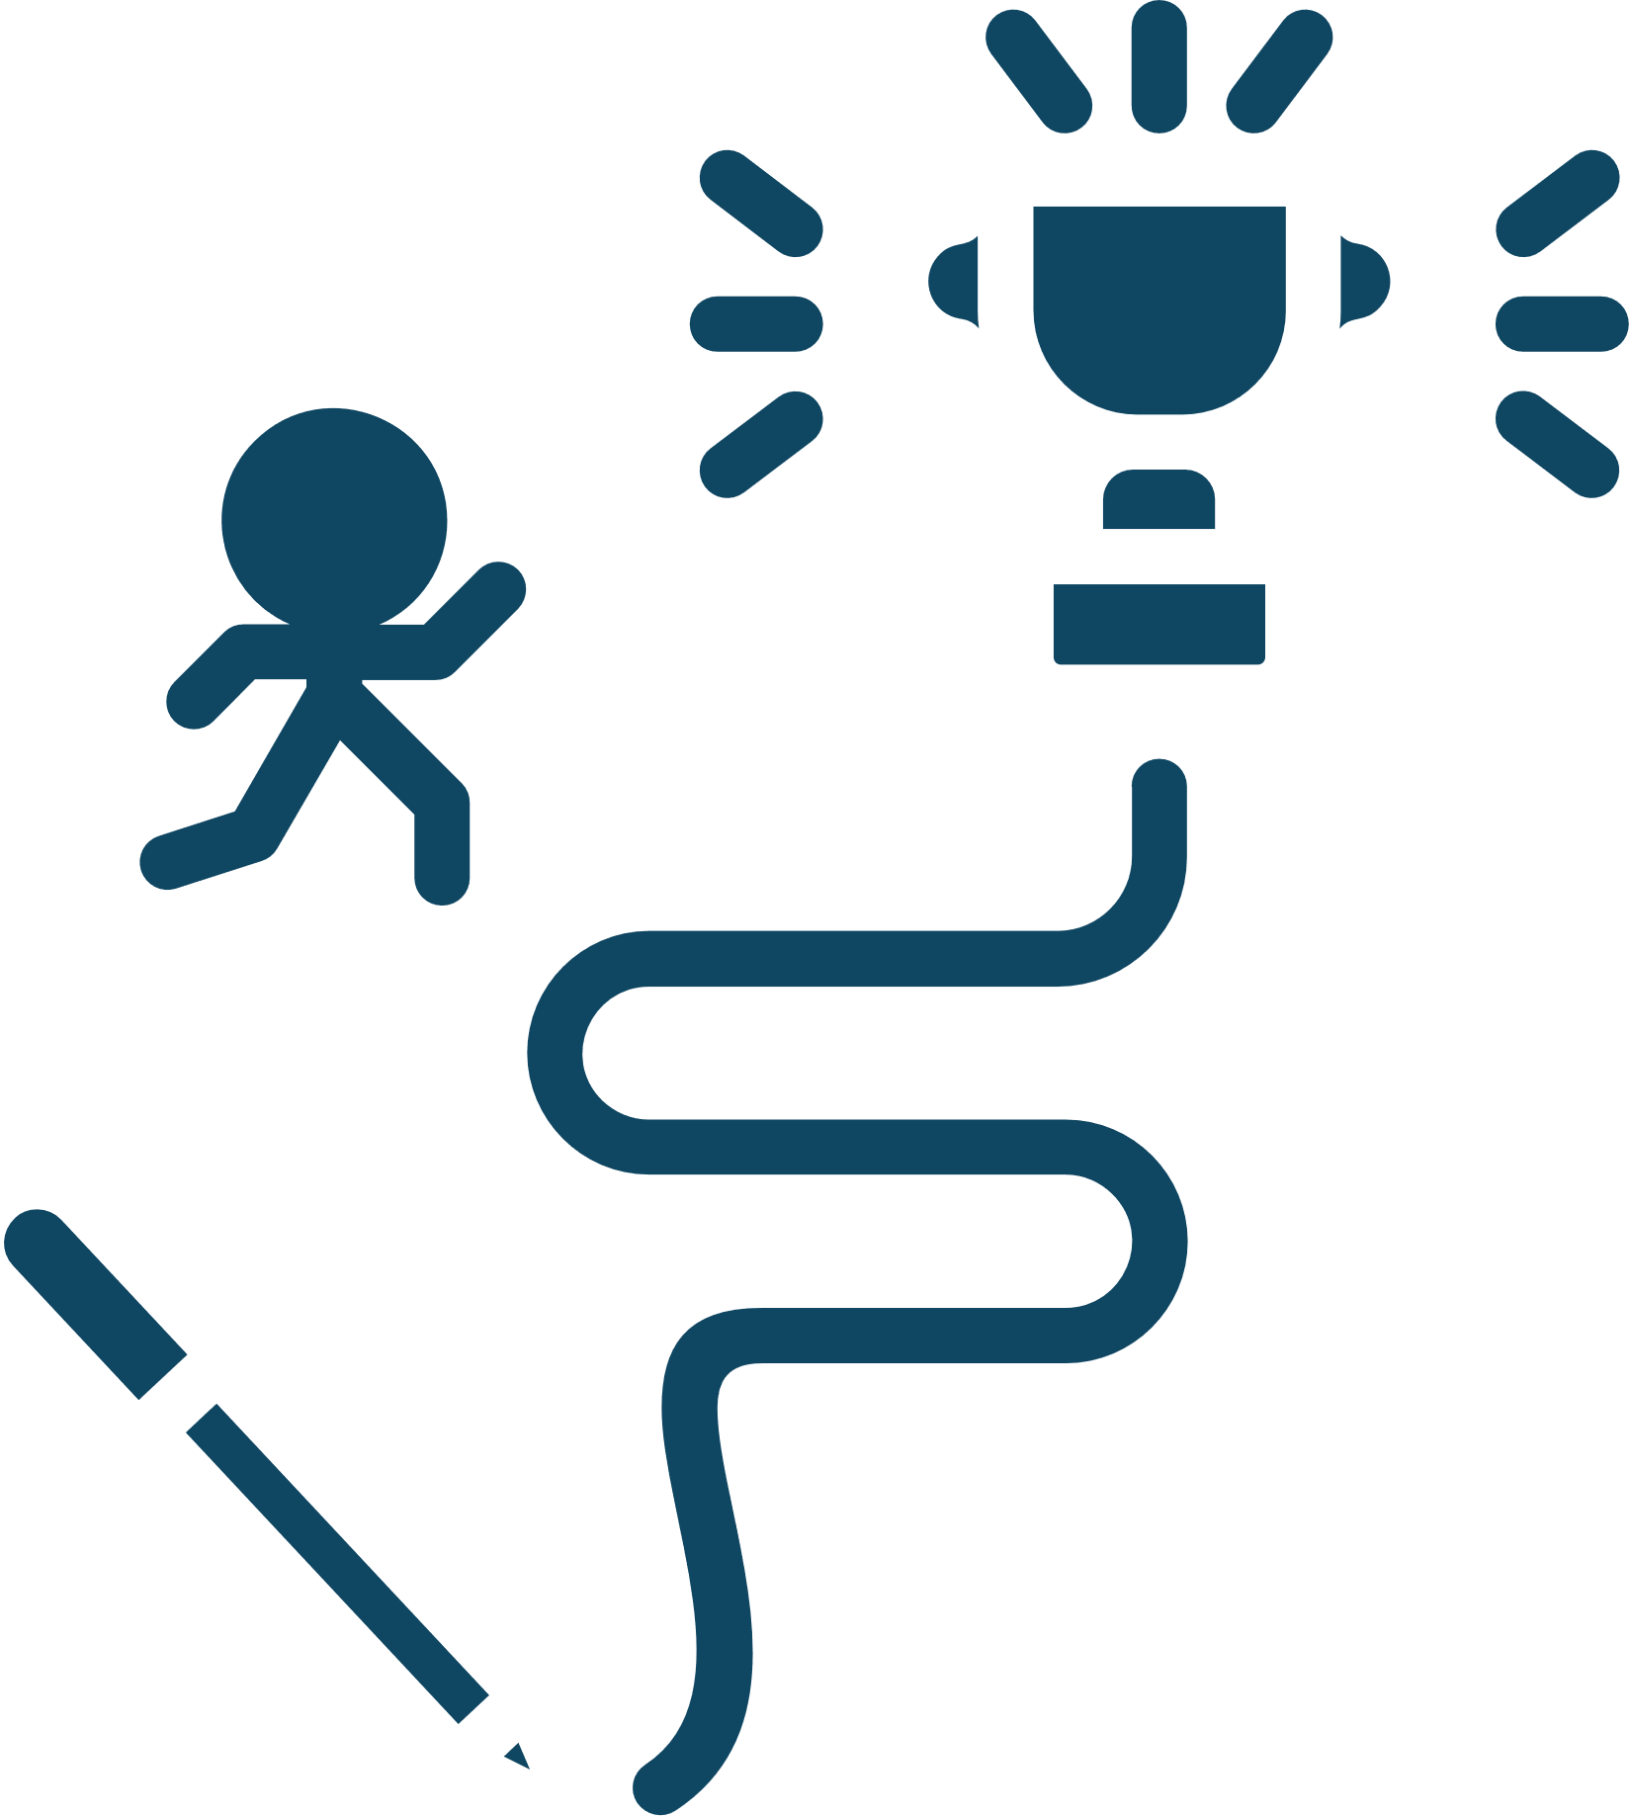
Challenges
1. Requirement of different fields of engineering:
Knowledge in mechincal and electric engineering.
Requesting assistance/guidance from correspending fields.
2. New Technology Integration:
Integrating IOT hardware system with Machine learning.
Adapt to skills different from traditional coding.
3. Data Accuracy:
Obtain reliable data for face and wheelchair detection.
No room for mistakes in real-time execution.

Slide 16
Future work and Improvents
1. Scaling the System for Multiple Artworks:
Scaling the IoT system across multiple paintings within a museum or gallery setting.
2. Maintenance and Monitoring System:
The proposed web application could provide real-time monitoring of critical system parameters, such as battery levels, connectivity status, and overall health of the components installed on each artwork.
Enhancing the maintenance system with data analytics capabilities would allow museum staff to analyze visitor interactions with specific artworks.

Slide 17
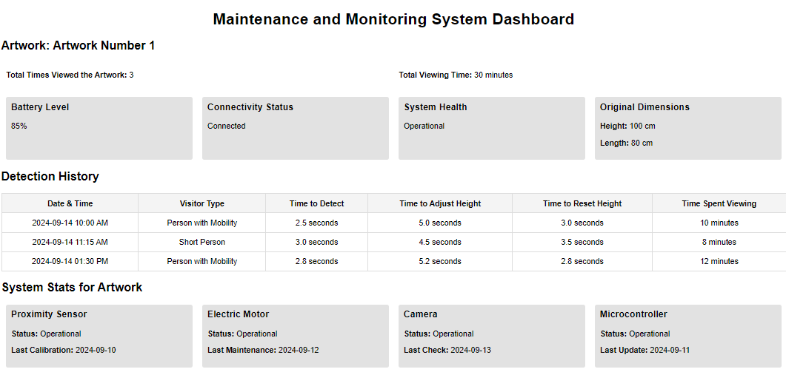
Viewing time of visitor
Battery level
Time for system to detect visitor
Updates

Slide 18

Thank You !
Questions?

